Slide 1

Introduction and analysis of an energy index to evaluate arm motion quality in neuromuscular patients
Presented by: Pouria Nozari Porshokouhi
Advisors: Saeed Behzadipour
Maryam Hoviattalab
September 2016

Slide 2

Outline
Outline
Background
Literature Review
Objective
Proposed Research
Method
Results
Conclusion
Future Works
Background
Future Works
Literature review
Outline
Conclusion
Objective
Results
Proposed research
Method

Slide 3
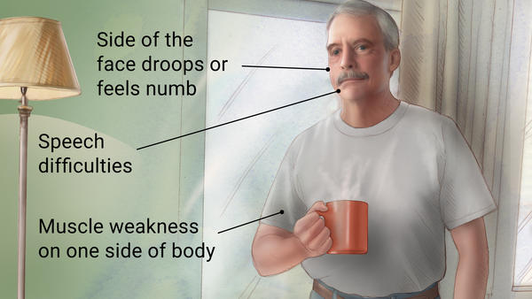
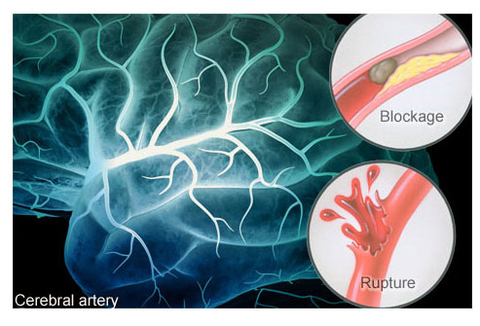
Outline
Background
Literature Review
Objective
Proposed Research
Method
Results
Conclusion
Future Works
Background
CVA or Cerebro-Vascular accident
Also referred to as a stroke
The sudden death of some brain cells
Caused by lack of oxygen amount carried to the brain by blood flow
Due to blockage of an artery
Due to Rupture of an artery

Slide 4
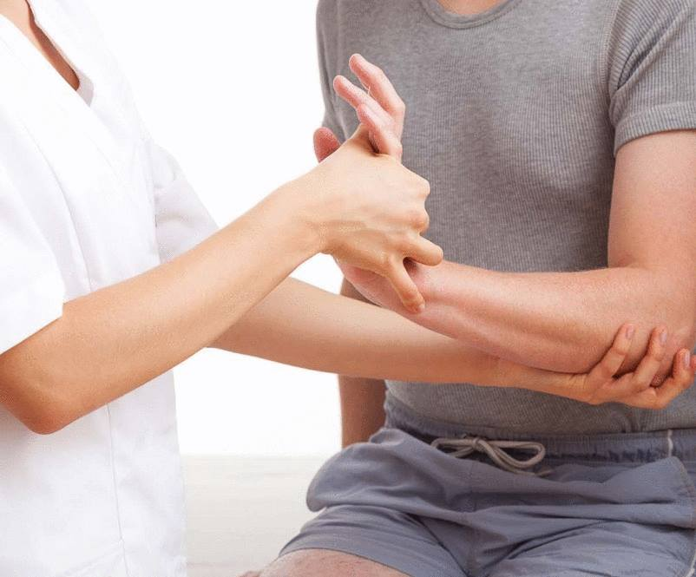
Background
Outline
Background
Literature Review
Objective
Proposed Research
Method
Results
Conclusion
Future Works
Gross Motion Rehabilitation
The very first and early motion by which any improvement can be observed
Efficient only when the exercises suit the patient’s level of capability, otherwise:
Not helping out the patient any more
The patient might droop and feel feeble

Slide 5
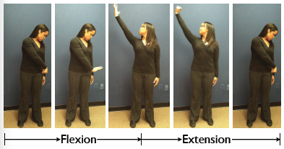
Background
Outline
Background
Literature Review
Objective
Proposed Research
Method
Results
Conclusion
Future Works
Motion quality diagnosis in neuromuscular patients
Diagnosis process
Patients’ current level
Patients’ improvement
Subjective motion quality rating
Individual errors might be involved
Overlap among the levels in such tests
Small amount of improvement might be neglected
Brunnstrom test

Slide 6
Background
Outline
Background
Literature Review
Objective
Proposed Research
Method
Results
Conclusion
Future Works
A suitable index needed to be proposed
Defining a more precise measure on motion quality
Strongly correlating with the qualitative indices
Defining the nature of the body motion

Slide 7
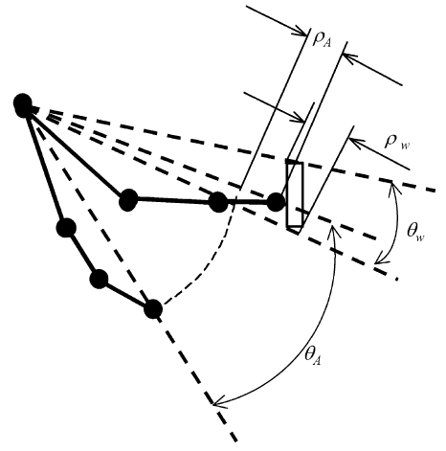
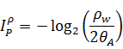
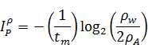
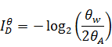
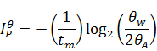
Literature Review
Outline
Background
Literature Review
Objective
Proposed Research
Method
Results
Conclusion
Future Works
Fitts’ Law
A mathematical relation between velocity, upper limb range of motion and target’s size
(Kondarske, 1994)
Quantitative motion quality evaluation
Fitts’ Law
General Systems Performance Theory
Signal Processing
Kinematic Indices

Slide 8
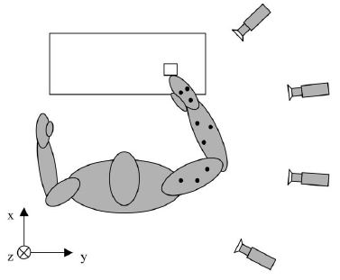
Literature Review
Outline
Background
Literature Review
Objective
Proposed Research
Method
Results
Conclusion
Future Works
Fitts’ Law
Yang et al., 2002
5 young healthy males
4 Vicon cameras with some markers
2D polar Fitts’ law
Indices of difficulty and performance
Smoothness index

Slide 9
Literature Review
Outline
Background
Literature Review
Objective
Proposed Research
Method
Results
Conclusion
Future Works
GSPT (General Systems Performance Theory)
Evaluating the performance of a system
Making up a relation among structure, function and performance
Fischer et al., 1997
Structure
Function
Performance

Slide 10
Outline
Background
Literature Review
Objective
Proposed Research
Method
Results
Conclusion
Future Works
Literature Review
Signal Processing
Mostly applied when Inertial sensors utilized
The output signal applied to create a pattern
Zhang et al., 2011
Motions advised by therapists performed by them
Motions captured by IMU sensors
Each motion segment signal obtained
A system trained by these patterns
Then the patients perform the motions
Their motion deviation from the trained patterns obtained

Slide 11
Literature Review
Outline
Background
Literature Review
Objective
Proposed Research
Method
Results
Conclusion
Future Works
Kinematic Indices
Butler et al., 2012
30 TD and 25 CP children
Reach & grasp cycles done
Based on 3D kinematics
A pediatric upper limb motion index (PULMI)
A proper negative correlation between the PULMI and MACS among CP (ρ=-0.78, p<0.0001)

Slide 12
Literature Review
Outline
Background
Literature Review
Objective
Proposed Research
Method
Results
Conclusion
Future Works
Kinematic Indices
Celik, 2010
Trajectory Error
Normal deviation from the desired path (a straight line)
Smoothness of Movement
Normal deviation from the velocity profile which generates the minimum jerk

Slide 13
Literature Review
Outline
Background
Literature Review
Objective
Proposed Research
Method
Results
Conclusion
Future Works
Kinematic Indices
Fakhar, 2013
49 HP CVA+ 6 normal subjects
Indices
Number of fluctuations of Jerk
Mean Jerk
Angle of clavicle made with the transverse plane
Elbow flexion
Mean velocity
Good correlation observed for
Mean velocity
Elbow flexion
No. of fluctuations of jerk

Slide 14
Literature Review
Outline
Background
Literature Review
Objective
Proposed Research
Method
Results
Conclusion
Future Works
Conclusion
Some of the indices are too much complicated and yield no physical or tangible concept
Desired level of reliability not achieved yet
Most of the motion analysis systems utilized costly systems, such as Vicon 3D system
Motion analysis systems needed markers
Kinetic nature of the arm motion ignored

Slide 15
Objective
Outline
Background
Literature Review
Objective
Proposed Research
Method
Results
Conclusion
Future Works
Introduction of an energy index
Both kinematics and dynamics involved
Seems to model the nature of the arm well
Classifying the motion quality of upper extremity
Validation of the energy index with the Brunnstrom grades

Slide 16
Proposed Research
Outline
Background
Literature Review
Objective
Proposed Research
Method
Results
Conclusion
Future Works
Milestones of the research
1
A musculo-skeletal model of arm developed
Compare the index values to Brunnstrom levels
4
Energy values normalized and the normal index obtained
3
The model simulated for actual motion data and the raw energy values obtained for subjects
2

Slide 17
Proposed Research
Outline
Background
Literature Review
Objective
Proposed Research
Method
Results
Conclusion
Future Works
Method overview
Skeletal model
Elbow & Wrist Position
Filtered Elbow & Wrist Position
Arm Kinematics
(Solved analytically via Matlab)
Motion Database
Filtration
Joints’ Kinematics
Metabolic Energy Raw Values
Muscle Energy Estimator
Arm Dynamics
(Solved via OpenSim)
Joints’ Torque Trajectories
Normalized Energy Index Values
Metabolic Energy Normalizer
Check if the Energy index correlates with the Brunnstrom grades
Brunnstrom Levels

Slide 18
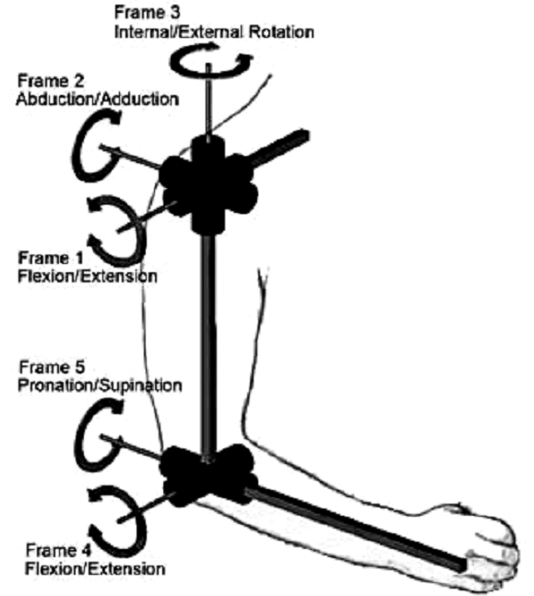
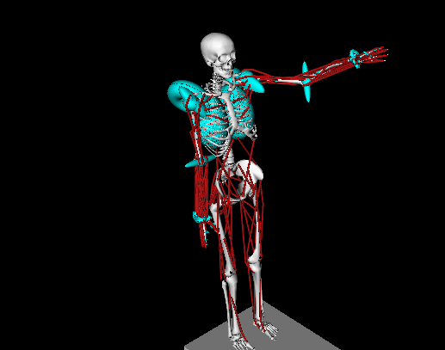
Outline
Background
Literature Review
Objective
Proposed Research
Method
Results
Conclusion
Future Works
Method
Conventional model of 4-DoF arm (redundant)
4-DoF arm model in OpenSim
Delp S.L. et al -> Lower-limb
Holzbaur K.R. et al. -> Upper-limb
Frame 3
Internal/External Rotation
Frame 2
Abduction/Adduction
Full Body Model
Frame 1
Flexion/Extension
Inactive in case the wrist is the end-effector
Frame 5
Pronation/Supination
Frame 4 Flexion/Extension

Slide 19
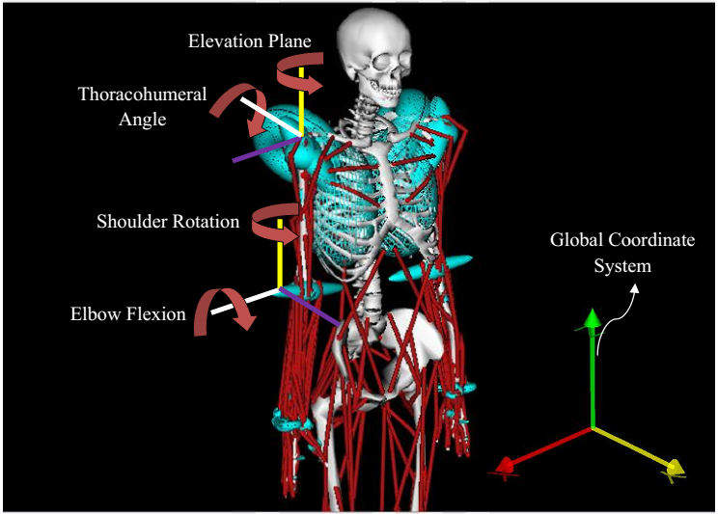
Outline
Background
Literature Review
Objective
Proposed Research
Method
Results
Conclusion
Future Works
Method
4 DoFs of upper limb model in present study

Slide 20
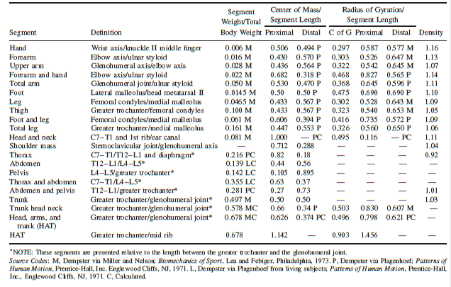
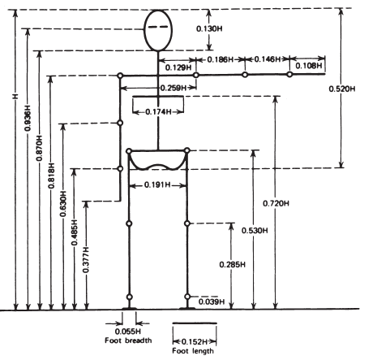
Outline
Background
Literature Review
Objective
Proposed Research
Method
Results
Conclusion
Future Works
Method
Anthropometric consideration (Winters, 2011)

Slide 21
Outline
Background
Literature Review
Objective
Proposed Research
Method
Results
Conclusion
Future Works
Method
Kinematic Reliability
The forward kinematics of the model solved for joints’ motion compared with the initial Cartesian motion data
The motion generated for the arm in OpenSim compared to that of the Matlab
Both cases checked → Inverse Kinematics reliable 

Slide 22
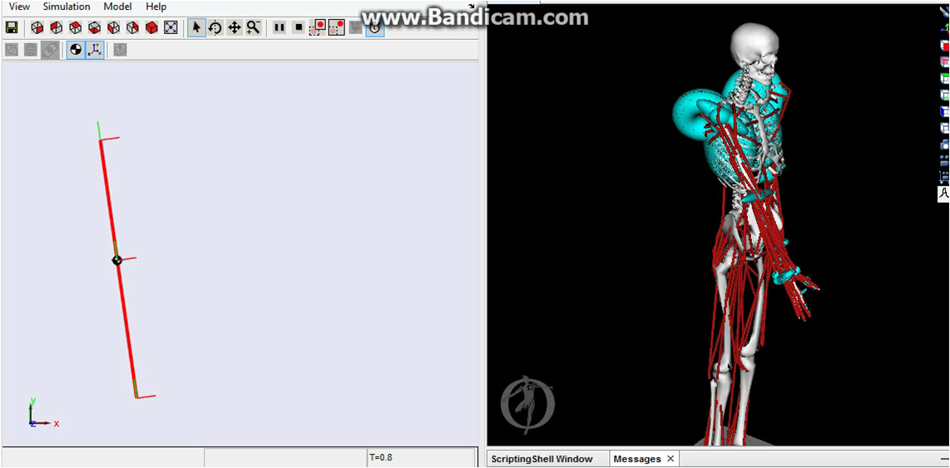
Outline
Background
Literature Review
Objective
Proposed Research
Method
Results
Conclusion
Future Works
Method
Dynamic verification
Some simulations conducted on SimMechanics
e.g. A trajectory for Shoulder Flexion (0-100 deg)
Forearm considered massless
SimMechanics
OpenSim

Slide 23
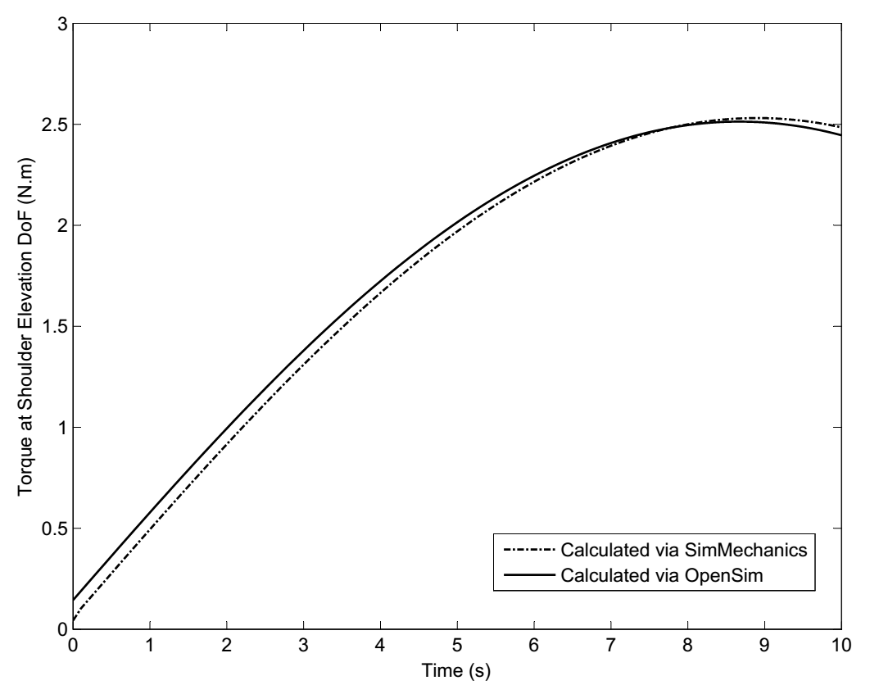
Outline
Background
Literature Review
Objective
Proposed Research
Method
Results
Conclusion
Future Works
Method
Dynamic verification
Result: Torque Trajectories

Slide 24
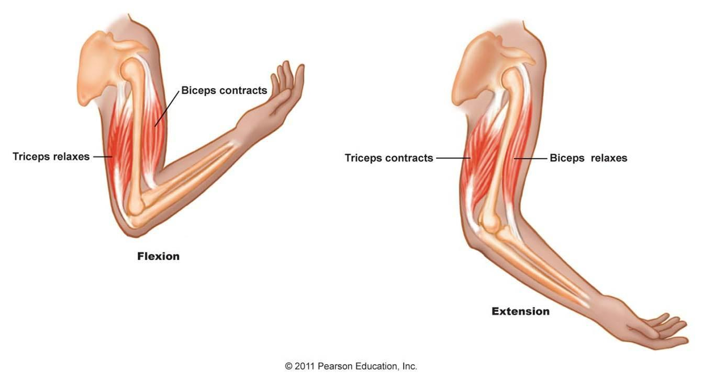
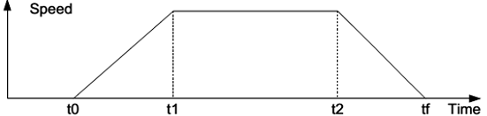
Outline
Background
Literature Review
Objective
Proposed Research
Method
Results
Conclusion
Future Works
Method
Muscle Energy Estimator (Zhu et al., 2011)
2 muscles in pair at each DoF
Only 1 muscle in a pair activated at each instant
2 types of contraction considered for each muscle:
Eccentric contraction
Concentric contraction
Biceps activated
Triceps activated
Biceps activated
Triceps activated
Triceps activated
Biceps activated

Slide 25
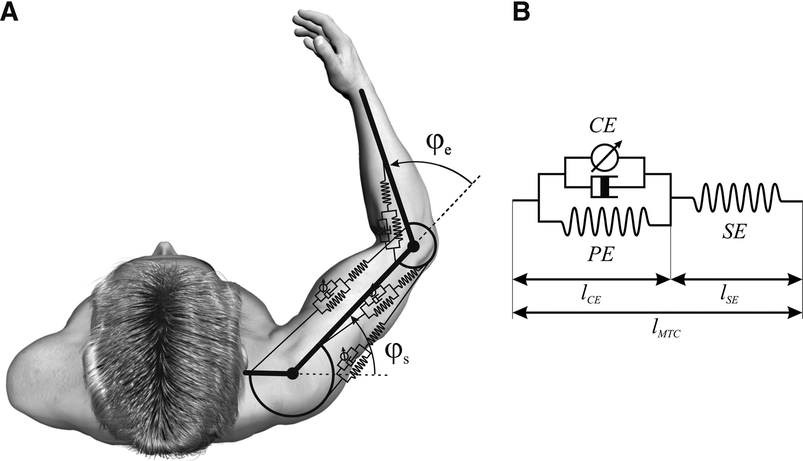
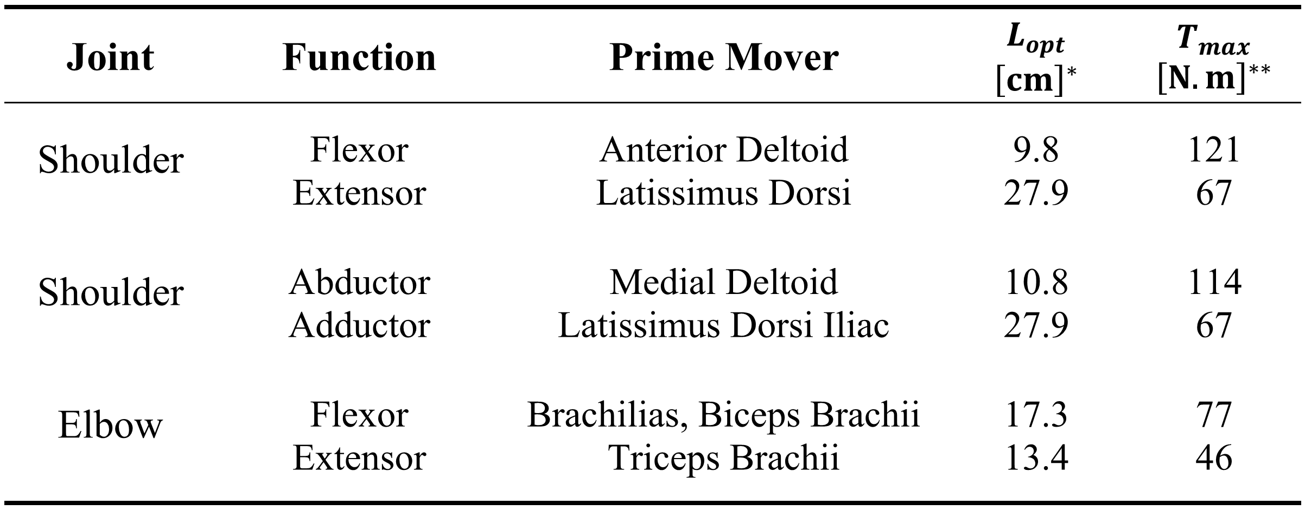
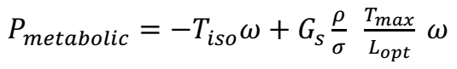
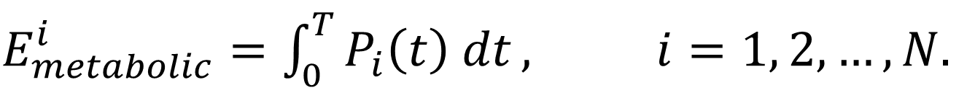
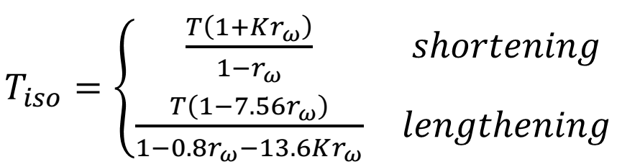
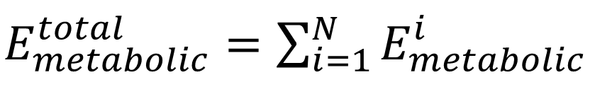
Outline
Background
Literature Review
Objective
Proposed Research
Method
Results
Conclusion
Future Works
Method
Muscle Energy Estimator (Zhu et al., 2011)
Can replace AnyBody wherever the overall behavior is of interest
2 muscles in pair at each DoF (Hill type muscles)
Metabolic power formulation

Slide 26
Outline
Background
Literature Review
Objective
Proposed Research
Method
Results
Conclusion
Future Works
Method
Normalization
Why Normalization?!!!
The index expected to evaluate the motion quality
The metabolic energy depend on some other parameters
Some important factors which come to mind at first look
Individual movement habits
Distance travelled by the hand
Movement velocity

Slide 27
Outline
Background
Literature Review
Objective
Proposed Research
Method
Results
Conclusion
Future Works
Method
Normalization
Distance travelled by the hands
→ Energy consumed per meter
→ somehow normalized

Slide 28
Outline
Background
Literature Review
Objective
Proposed Research
Method
Results
Conclusion
Future Works
Method
Normalization
Individual movement habits and patterns
Different amounts of energy obtained for two subjects
Does it represent difference in their motion quality?!!!
It might be due to different individual patterns
→ Normalized value of the paralyzed/not dominant side divided by that of the healthy/dominant side

Slide 29
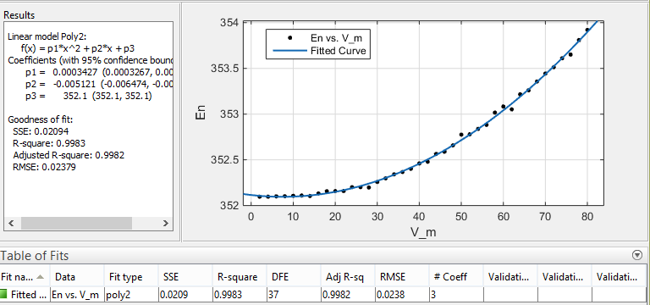
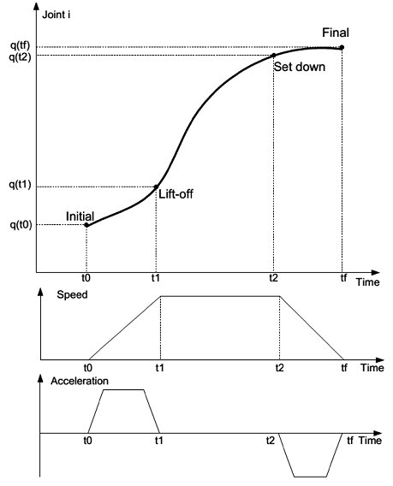
Outline
Background
Literature Review
Objective
Proposed Research
Method
Results
Conclusion
Future Works
Method
Normalization
Velocity
Model: a simple pendulum in SimMechanics
Input: a trapezoidal trajectory for velocity
Output: Metabolic Energy vs. Max Velocity
Motion: 0-110 deg
100 different values
for joint’s maximum
angular velocity:
(1-100 deg/s)

Slide 30
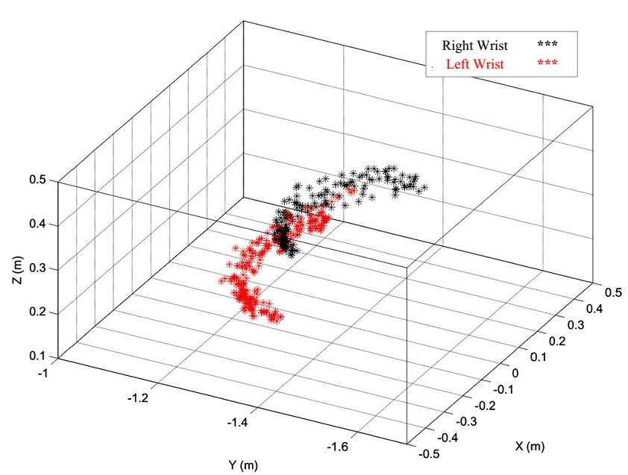
Outline
Background
Literature Review
Objective
Proposed Research
Method
Results
Conclusion
Future Works
Method
Initial evaluation of the index
Normal hand motion
Simulated-disabled hand motion
Consumed energy normalized by distance and velocity
Motion type | Normal Energy | Distance travelled(m) | Time (s)
Horizontal, right, normal | 5200 | 9.13 | 15.53
Horizontal, left, normal | 5047 | 14.38 | 21.55
Horizontal, Left, disabled | 6229 | 14.13 | 26.70
Vertical, right, normal | 4685 | 17.07 | 18.35
Vertical, left, disabled | 6123 | 26.90 | 23.36

Slide 31
Outline
Background
Literature Review
Objective
Proposed Research
Method
Results
Conclusion
Future Works
Method
Clinical Data
34 HP CVA patients + 6 normal subjects
4 various types of motion for each subject
Horizontal motion
Vertical motion
Diagonal motion
Repetitive motion
Motions captured by Kinect at 30 Hz
Some outlier motion data observed and disregarded

Slide 32
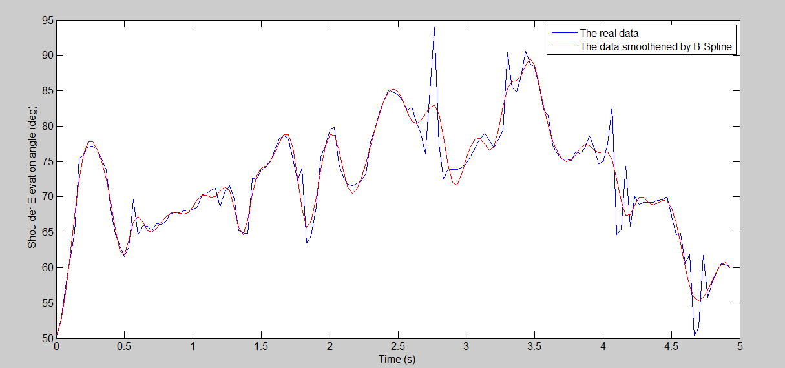
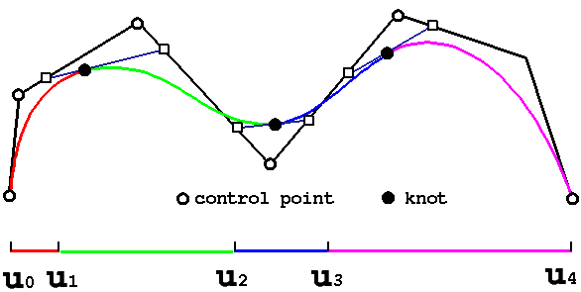
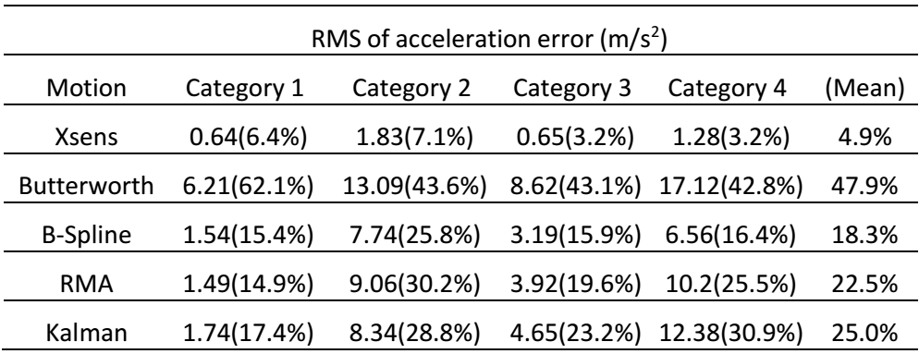
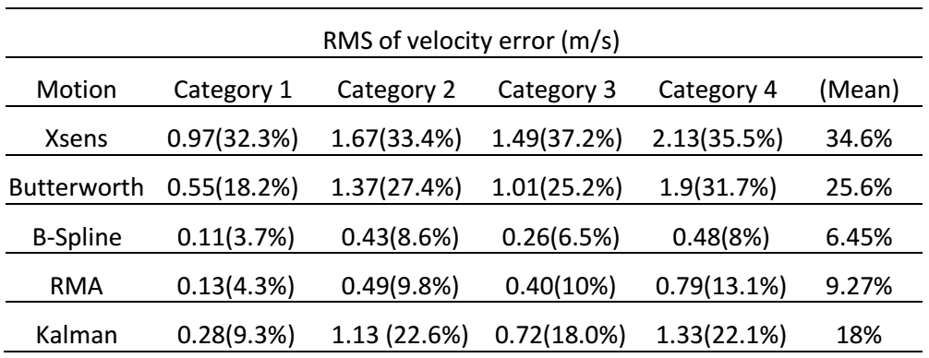
Outline
Background
Literature Review
Objective
Proposed Research
Method
Results
Conclusion
Future Works
Method
Filtration
Apply the motion to the arm model
1st and 2nd derivatives needed
The motion data contains a noisy part
Derivation might lead to really massive jumps in velocity, …
Filtration required
B-Spline method
Cubic B-Spline (of 4th order) \(Mobini, 2015)

Slide 33
Outline
Background
Literature Review
Objective
Proposed Research
Method
Results
Conclusion
Future Works
Results
A shortcoming lies within the model
An inherent singular configuration involved
Whenever the elbow flexion relatively infinitesimal
→ Problem with solving the shoulder rotation DoF
→ Shoulder rotation torque changes erratically
→ The shoulder rotation torque neglected in energy summation

Slide 34
Outline
Background
Literature Review
Objective
Proposed Research
Method
Results
Conclusion
Future Works
Results
 | Normalized by: Distance travelled Individual patterns | Normalized by: Distance travelled Velocity of motion Individual patterns
Horizontal |  | 
Vertical |  | 
Diagonal |  | 
Repetitive |  | 
Normalization
Type
Motion Type

Slide 35
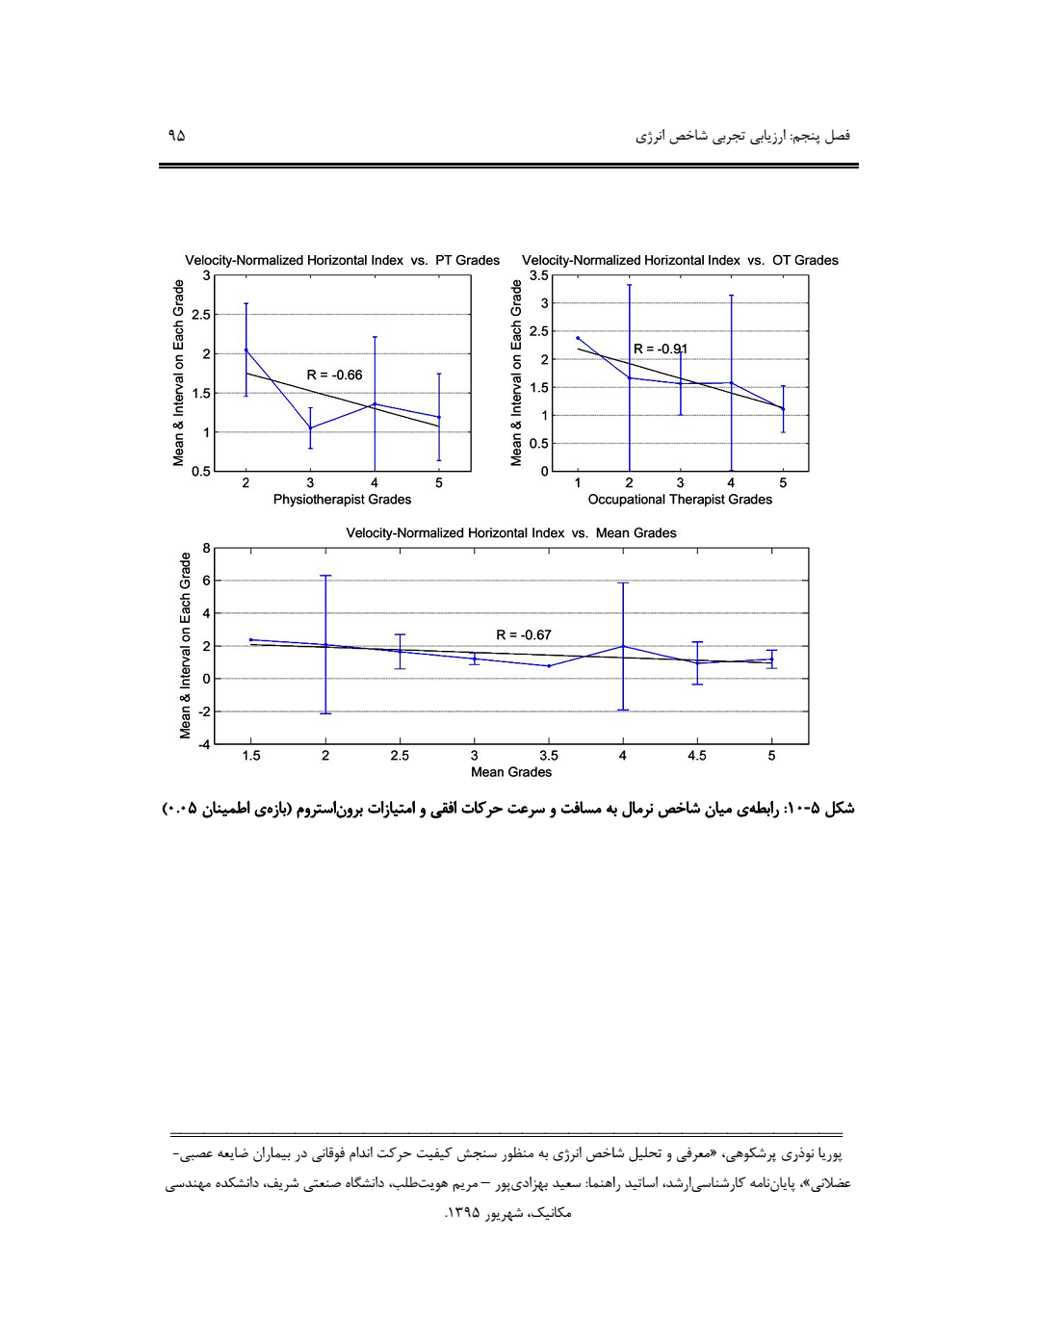
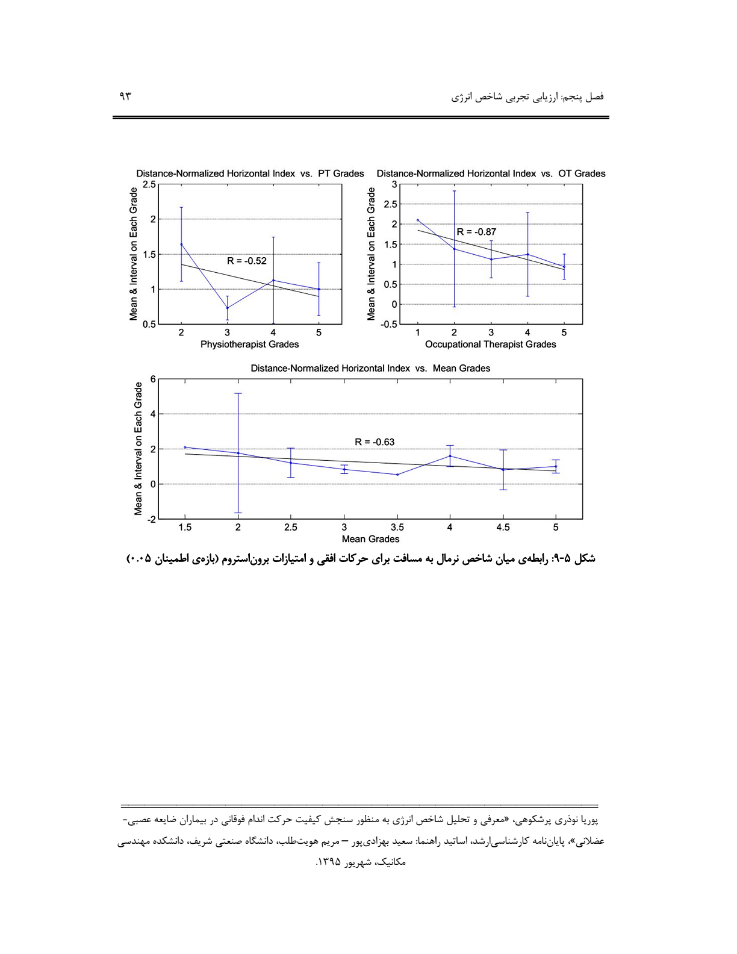
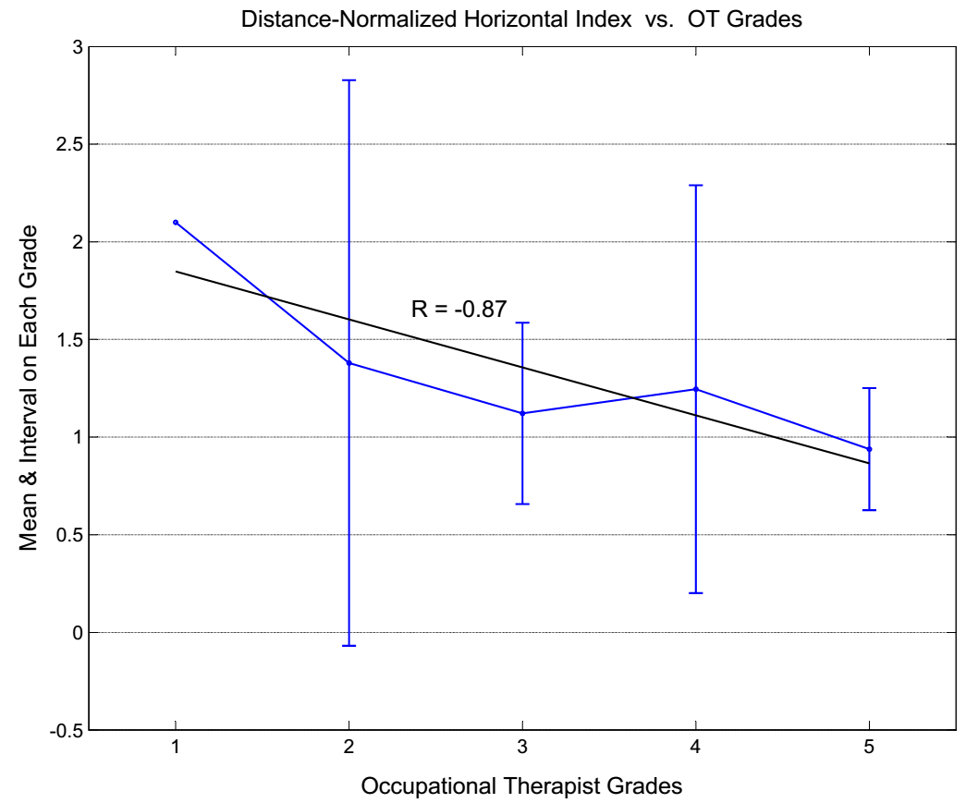
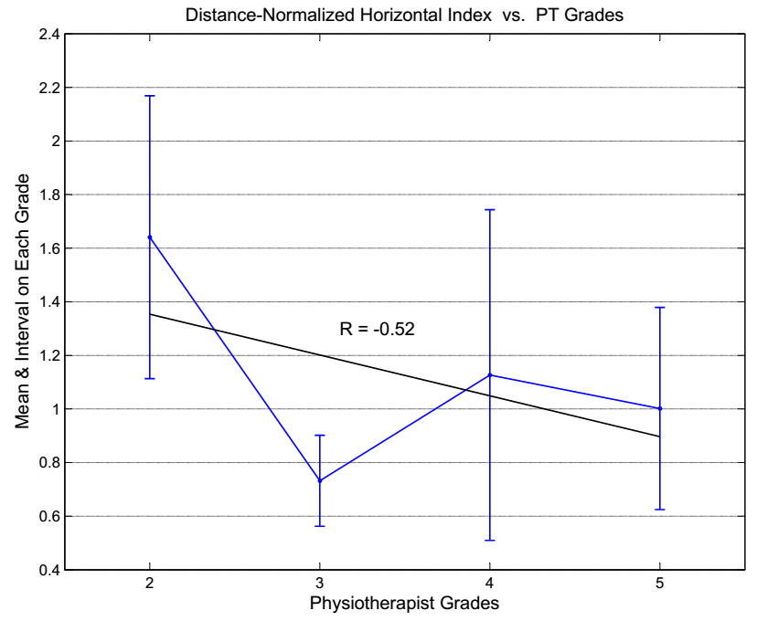
Outline
Background
Literature Review
Objective
Proposed Research
Method
Results
Conclusion
Future Works
Results (Horizontal Motion)

Slide 36
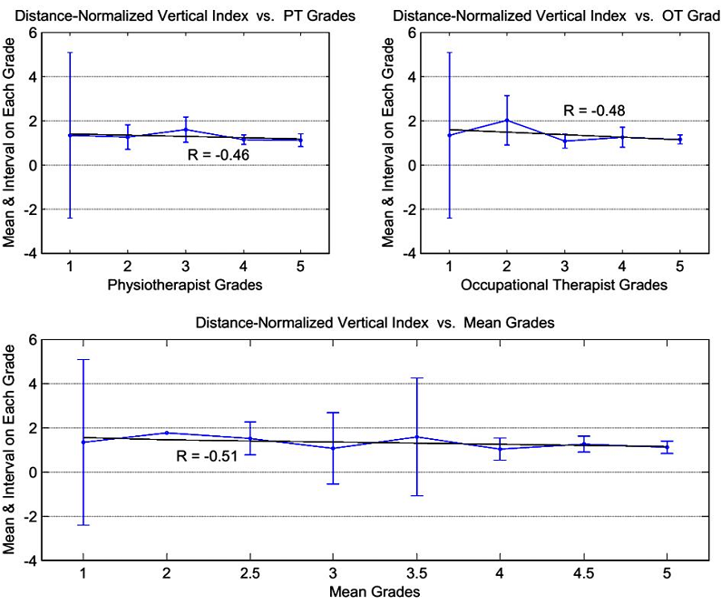
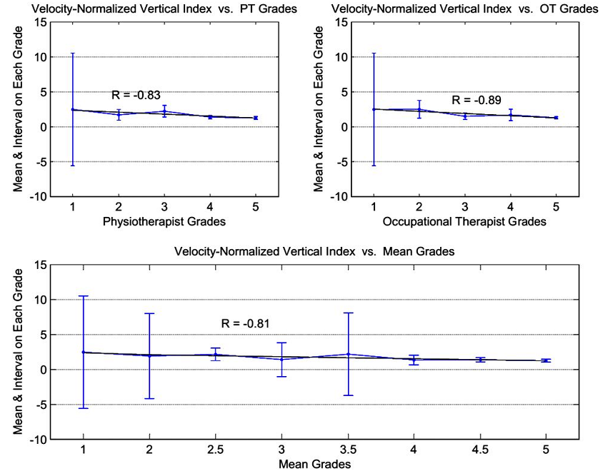
Outline
Background
Literature Review
Objective
Proposed Research
Method
Results
Conclusion
Future Works
Results (Vertical Motion)

Slide 37
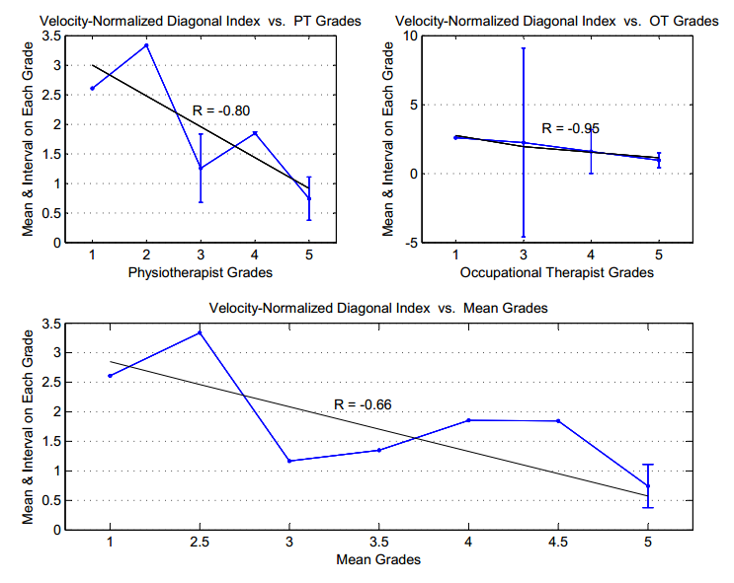
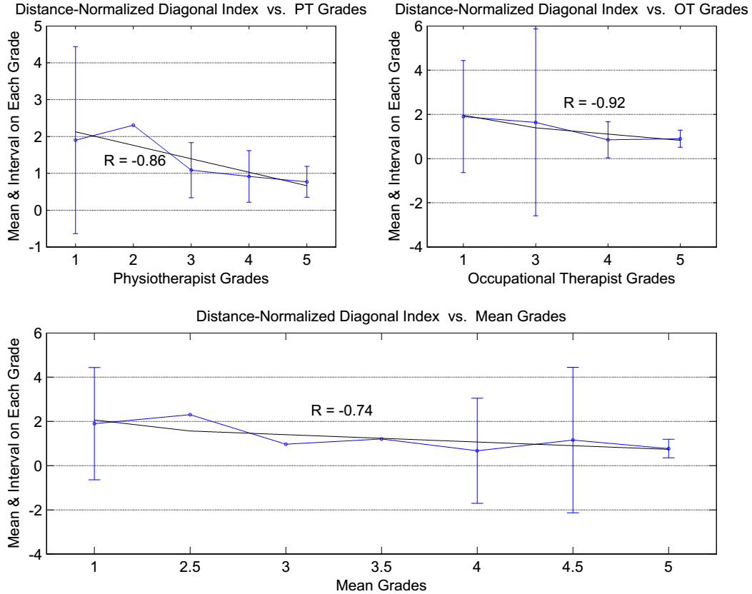
Outline
Background
Literature Review
Objective
Proposed Research
Method
Results
Conclusion
Future Works
Results (Diagonal Motion)

Slide 38
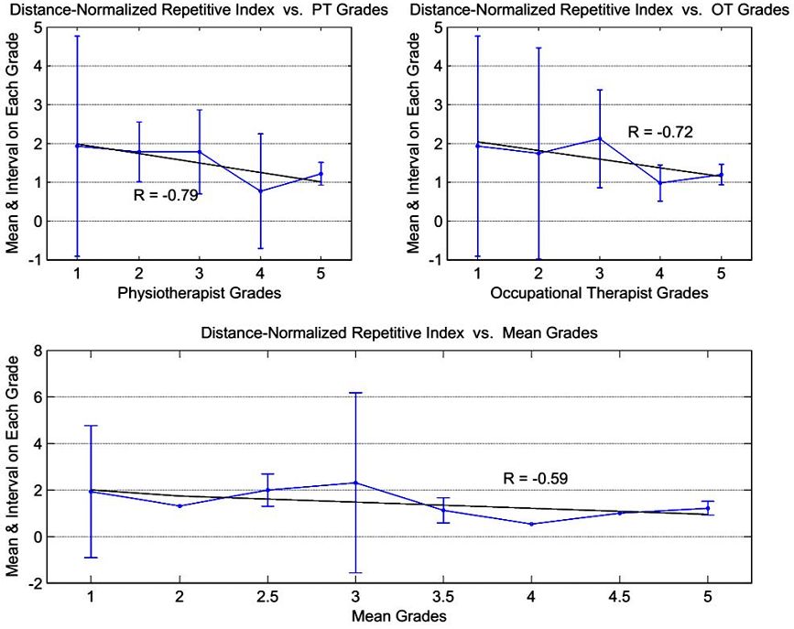
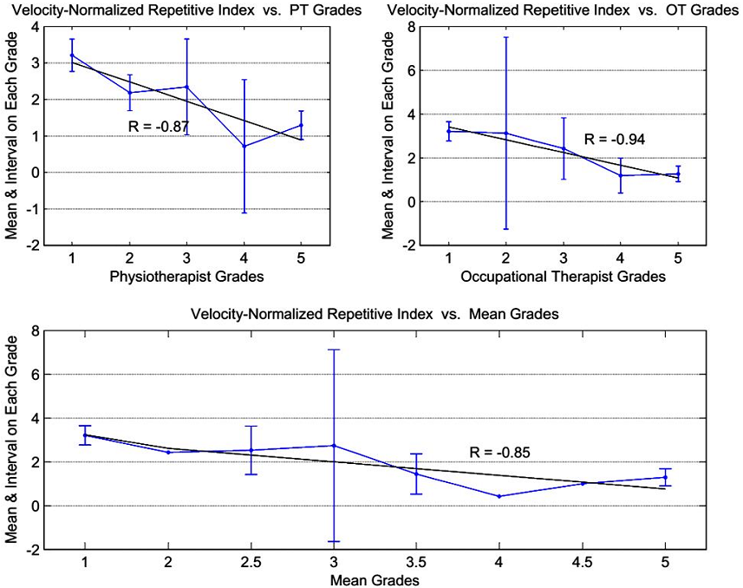
Outline
Background
Literature Review
Objective
Proposed Research
Method
Results
Conclusion
Future Works
Results (Repetitive Motion)

Slide 39
Outline
Background
Literature Review
Objective
Proposed Research
Method
Results
Conclusion
Future Works
Results (Cross Correlation Values)
 | Normalized by: Distance travelled Individual patterns |  |  | Normalized by: Distance travelled Velocity of motion Individual patterns
 | PT | OT | Mean | PT | OT | Mean
Horizontal | -0.32 | -0.38 | -0.36 | -0.37 | -0.40 | -0.40
Vertical | -0.21 | -0.31 | -0.27 | -0.43 | -0.52 | -0.48
Diagonal | -0.73 | -0.63 | -0.68 | -0.84 | -0.81 | -0.84
Repetitive | -0.32 | -0.37 | -0.35 | -0.50 | -0.60 | -0.56
Mean | -0.59 | -0.64 | -0.63 | -0.67 | -0.73 | -0.72
Normalization
Type
Motion
Type

Slide 40
Outline
Background
Literature Review
Objective
Proposed Research
Method
Results
Conclusion
Future Works
Conclusion
Qualitative indices may confuse the therapists
Individual disagreements
Due to the overlaps
Lower levels of improvements may be neglected
No good reliability in kinematic indices
Not modeling the kinetic nature of the limb motion
Some indices too complicated
An energy index proposed
Both Kinematics & Dynamics taken into account
Normalized to get to energy index
Correlation analysis carried out

Slide 41
Outline
Background
Literature Review
Objective
Proposed Research
Method
Results
Conclusion
Future Works
Future Works
To be compared to other kinematic indices
Energy index might be unable to classify on its own
Maybe better to exploit some other indices in company with the energy index
More controlled experiments to be conducted

Slide 42


Slide 43


